Slide 1
Evaluating Sequential Autoencoder Ensemble for Anomaly Detection
By Phuong Huong Nguyen
Supervised by:
Prof. Dr. Emmanuel Müller
Simon Klüttermann, M.Sc.

Slide 2
Table of contents
01
02
03
04
Motivation
Sequential Autoencoder Ensemble Techniques
Experiments and Evaluation
Conclusion and future work

Slide 3
01
Motivation

Slide 4
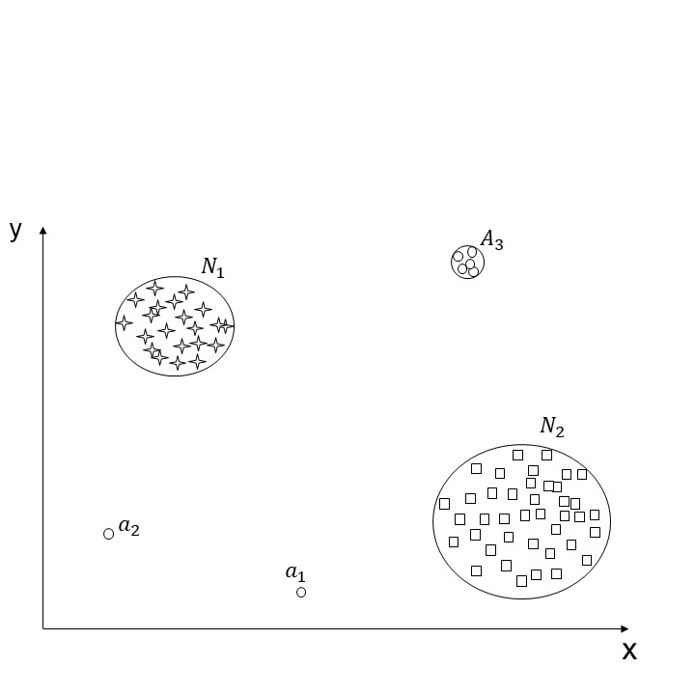
Motivation
Anomaly Detection:
The process of finding objects of a given dataset that behave very different from expectation
Figure 1: An example of anomalies in a two-dimensional dataset

Slide 5
Motivation
Unsupervised Anomaly Detection:
Autoencoders
Independent Autoencoder Ensemble Methods: RandNet
The problem of low variance between components in an ensemble
The opportunity for sequential ensemble techniques
Notes:
Depending on the availability of labeled data, it could be considered to solve an anomaly detection problem with supervised, semi-supervised, or unsupervised learning.
However, having labeled datasets for anomaly detection problems could be very challenging in real-world scenarios, especially when the volume of data becomes larger and larger, which is occurring in this new era of big data. Therefore, unsupervised anomaly detection problems have obtained more attention from studies.
the most powerful algorithms for unsupervised anomaly detection is autoencoder,
the approach to leveraging the strength of various models to generate a more robust model, which is known as the ensemble method, has been explored widely for anomaly detection problems. The most remarkable architectures are independent autoencoder ensembles, which combine multiple autoencoder models in many different ways. RandNet is one of the most remarkable architectures.
However, these architectures tend to produce similar base learners. As a low variance between components, it may not obtain more significant improvements than using an individual autoencoder. To address the problem of variance, we propose various sequential autoencoder ensemble techniques

Slide 6
02
Sequential Autoencoder Ensemble Techniques
Notes:
- In the next section, we will dig deep into their architectures and characteristics

Slide 7
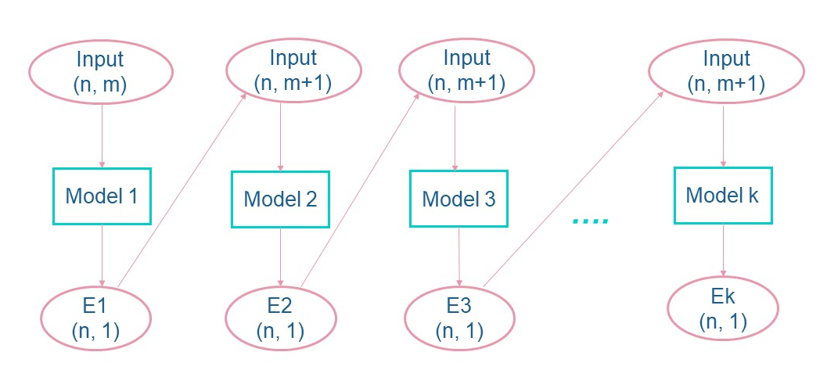

Sequential Autoencoder Ensemble (SAE)
The reconstruction error of the last trained learner will be added as a feature to the original dataset D(n, m) before training the next model
$$E_{1}=MSE(D\left(n, m\right), D^{′}\left(n, m\right))$$
$$E_{i}=MSE(D\left(n, m+1\right), D^{′}\left(n, m+1\right))$$
Figure 2: The architecture of SAE used in the experiments
Notes:
- SAE contains K autoencoders as base learners.
- Our SAE can generate autoencoder models with highly different results as the prediction of the previous model is used to correct the error of the next one.
- Reconstruction error = Mean square error of difference between an input and its reconstruction
- The average of the entire base learners' prediction errors defines the final prediction error of the full sequential autoencoder ensemble.

Slide 8
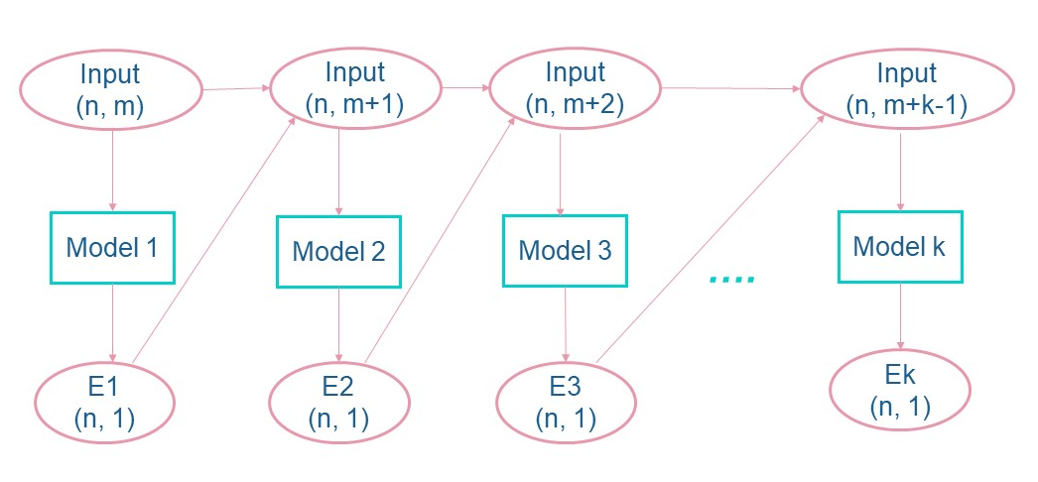
Full Sequential Autoencoder Ensemble (FSAE)
The reconstruction error of all previous trained learners will be added as features to the original dataset D(n, m) before training the next model
Figure 3: The architecture of FSAE used in the experiments
$$E_{i}=MSE(D\left(n, m+i −1\right), D^{′}\left(n, m+i − 1\right))$$
Notes:
The next variant is full sequential autoencoder ensemble
The difference from sequential autoencoder ensemble is that the reconstruction error…

Slide 9
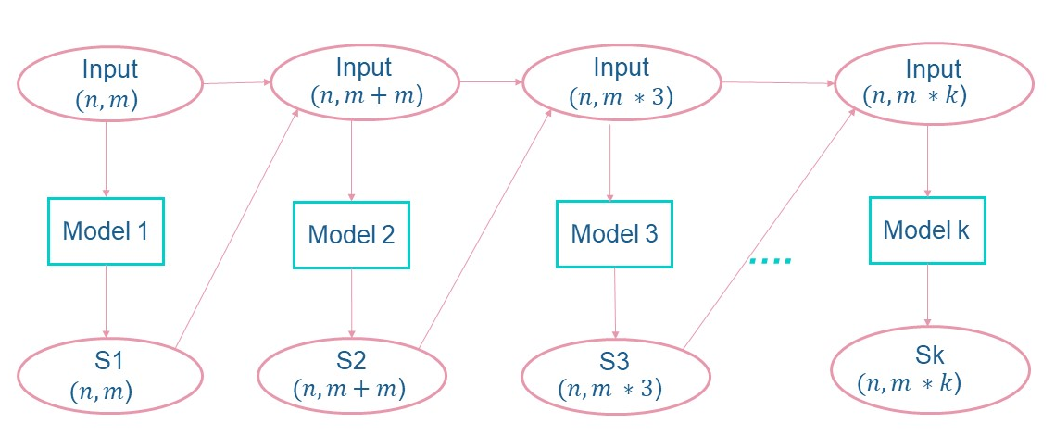
Synchronizing Sequential Autoencoder Ensemble (SSAE)
The dimensions of reconstruction error of all previous trained learners are kept intact and will be added as features to the original dataset D(n, m) before training the next model
Figure 4: The architecture of SSAE used in the experiments
$$S_{i}={\left(D\left(n, m ∗i\right) − D^{′}\left(n, m ∗i\right)\right)}^{2}$$
Notes:
And the last method which we call synchronizing sequential autoencoder ensemble is expanded from the previous variant
In this technique, the dimensions of reconstruction error…

Slide 10
03
Experiments and Evaluation
Notes:
- In this third section, i present various experiments as well as evaluation of model‘s performance

Slide 11
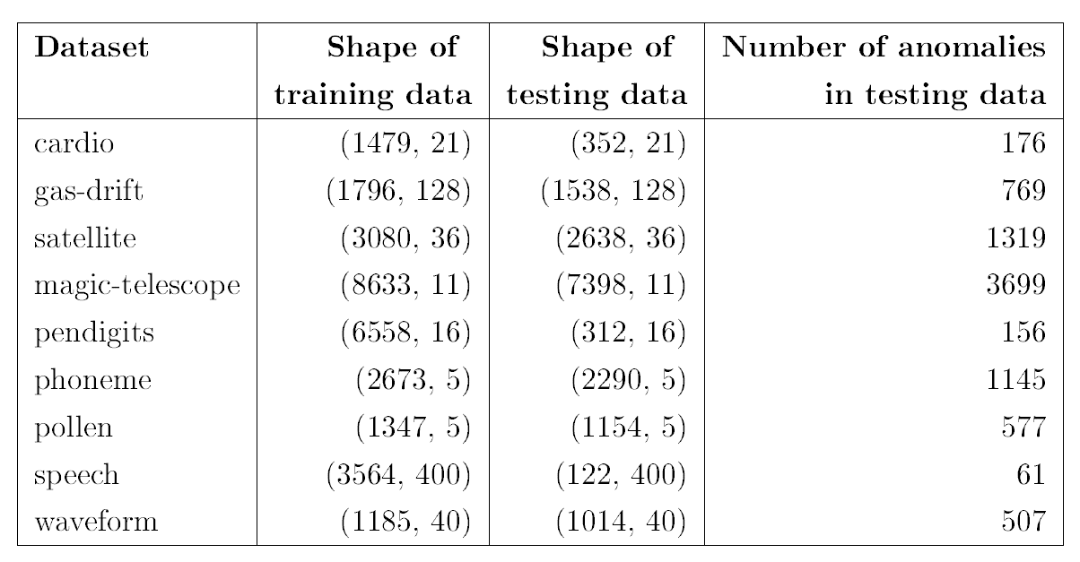
Overview of datasets
Table 1: List of datasets used in experiments and their size
Notes:
- This table gives us an overview about all datasets that i used in the experiments

Slide 12
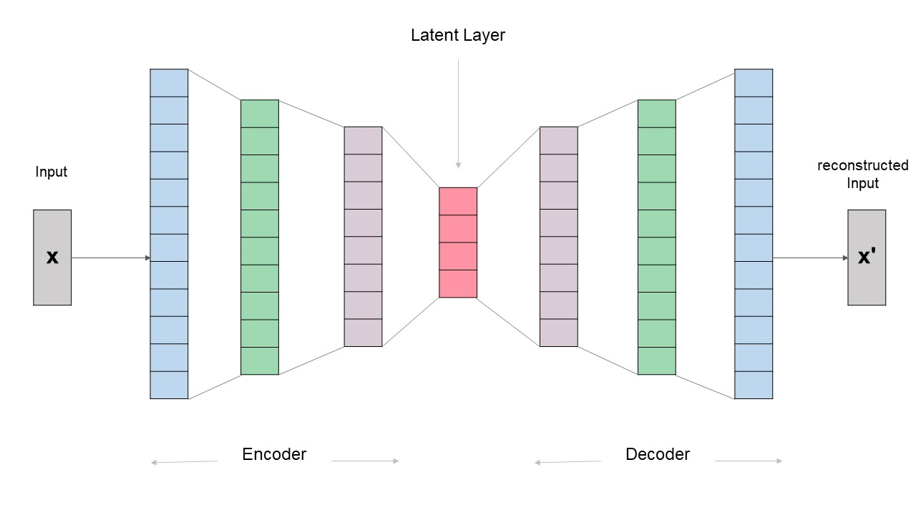
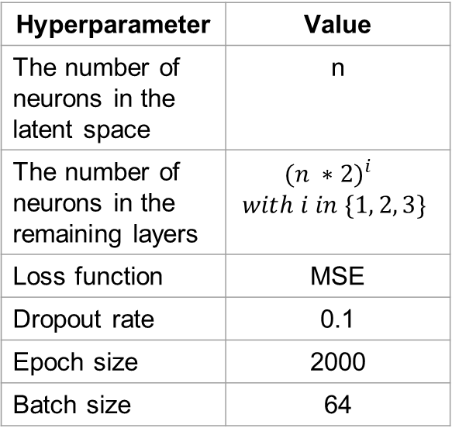
The Approach with Autoencoder Model
Hyperparameter | Value
The number of neurons in the latent space | n
The number of neurons in the remaining layers | $${(n ∗2)}^{i}$$ $$with i in \{1, 2, 3\}$$
Loss function | MSE
Dropout rate | 0.1
Epoch size | 2000
Batch size | 64
Figure 5: The architecture of autoencoder used in the experiments
Notes:
- The figure 5 shows the architecture of an autoencoder used in the experiments
- The network includes seven layers - one input, two hidden in the encoder block, and one output layer, two hidden in the decoder block. These blocks are symmetric by the latent layer in between
- We keep the number of neurons n in the latent space as a variable that should be set up appropriately according to each used dataset.
- The values of other hyperparameters can be seen in the table beside

Slide 13
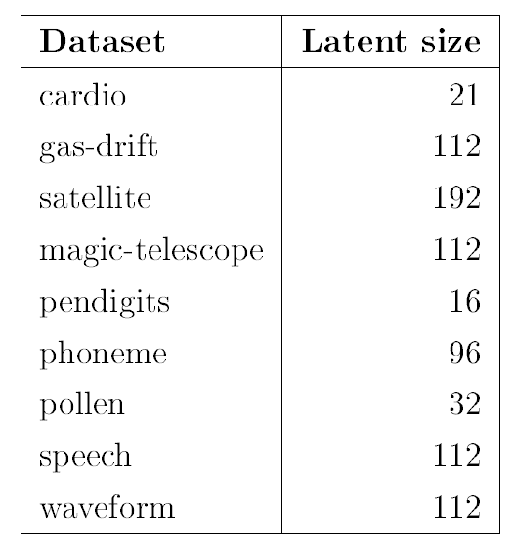
1. Batch and Epoch size analysis
The Approach with Autoencoder Model
Inspect the effect of batch size:
Batch sizes = {16, 32, 64, 128, 256, 512}
Epoch = 2000
Inspect the effect of epoch size:
Epoch sizes = {50, 100, 200, 500, 1000, 1500, 2000, 2500, 3000, 3500, 4000}
Batch = 64
Table 2: Latent size used to train autoencoders for each dataset
Notes:
- The purpose of implementing experiments regarding some hyperparameters like batch size, epochs, and latent space is to analyze their effects on the performance of an autoencoder model for anomaly detection problems and figure out the most suitable values of hyperparameters for each dataset used in this thesis.
- To see how the batch size hyperparameter affects the performance of an autoencoder model, we trained multiple autoencoder models for each dataset with various batch sizes and the same epoch of 2000.
- Similarly, to inspect the effect of epoch sizes on the performance of an autoencoder model, we trained multiple autoencoder models for each dataset with different epoch sizes and the same batch of 64

Slide 14
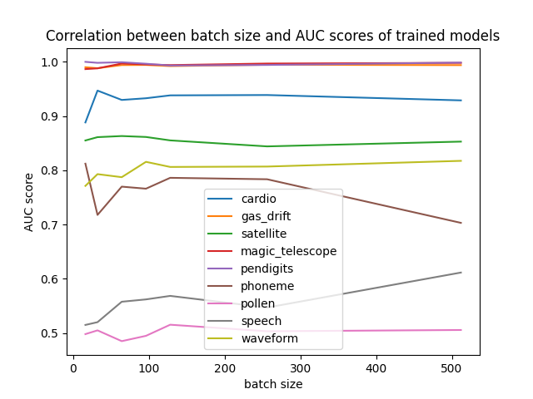
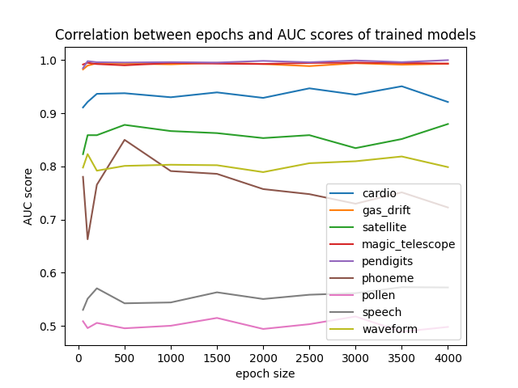
1. Batch and Epoch size analysis
The Approach with Autoencoder Model
Figure 6: The influence of batch size
Figure 7: The influence of epoch size
Both batch and epoch parameters can help to improve the performance of an autoencoder model for anomaly detection problem
Notes:
- As we can see in figure 6, the correlation between batch sizes and AUC scores of trained models is not high. In particular, most datasets tend to obtain a stable AUC score, when the batch size is increased. Only the phoneme and speech datasets stay out of this tendency, but the fluctuation of their AUC scores is not significant. From the experiment, we found out that the batch size parameter can help to improve the performance of an autoencoder model for anomaly detection problems to some extent.
- The figure 7 shows that the epoch parameter has a similar trend with the batch size.

Slide 15
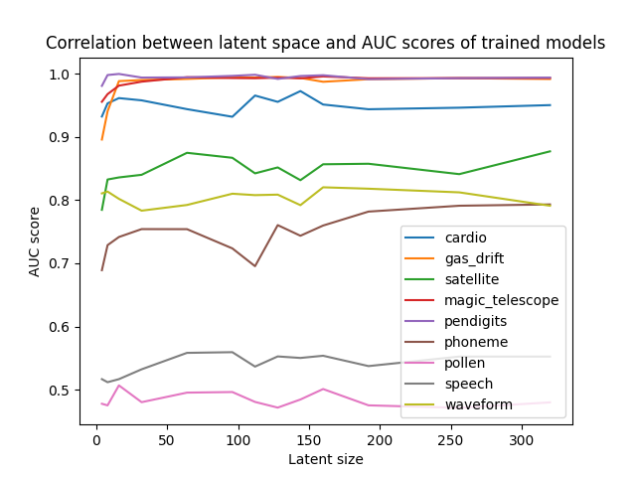
2. Latent Space analysis
The Approach with Autoencoder Model
By setting a suitable latent space, we can train an outstanding autoencoder model with only a shallow neuron network
The latent space of an autoencoder does not need to be smaller than the number of features of a dataset.
Figure 8: The influence of latent size
Notes:
- Next, to inspect the influence of latent space, for each dataset, we trained multiple autoencoder models with different latent space values
- The figure 8 indicates the correlation between the latent space and AUC scores
- The experiments have proved that the latent space parameter affects significantly the performance of an autoencoder model
- As we can see in the plot, there is a substantial fluctuation in AUC scores concerning latent sizes of autoencoders, except for those of gas-drift, magic-telescope and pendigits datasets, which are quite easy to train
- By setting a suitable latent space, we can train an outstanding autoencoder model with only a shallow neuron network
- Also, we see that the latent space of an autoencoder does not need to be smaller than the number of features of a dataset. A dataset with few features can get the highest AUC score by using an autoencoder with a large latent space

Slide 16
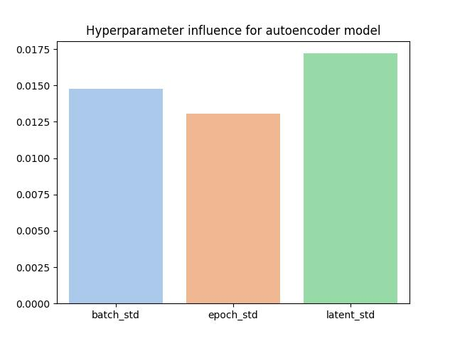
The Approach with Autoencoder Model
The latent space has the highest influence on the performance of an autoencoder model
With a set of proper hyperparameters, we can attain a simple but robust autoencoder model for anomaly detection problems
Figure 10: The variance through hyperparameters on an autoencoder
Notes:
- In general, all batch, epoch sizes, and latent space contribute to improving an autoencoder model’s performance
- Figure 10 illustrates the influence extent of each parameter on the performance of an autoencoder.
- From the plot, we see that the latent space has the highest influence
- With a set of proper hyperparameters, we can attain a simple but robust autoencoder model for anomaly detection problems
- However, searching for appropriate hyperparameters may lead to a high computational cost and be time-consuming
- Moreover, this approach is not effective in general since it does not generalize about all anomaly detection problems. That means we need to find a proper hyperparameter set for a particular dataset to be able to train a well-performing autoencoder

Slide 17
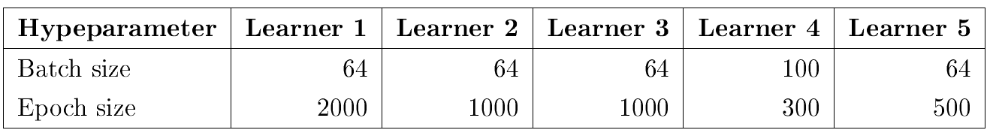
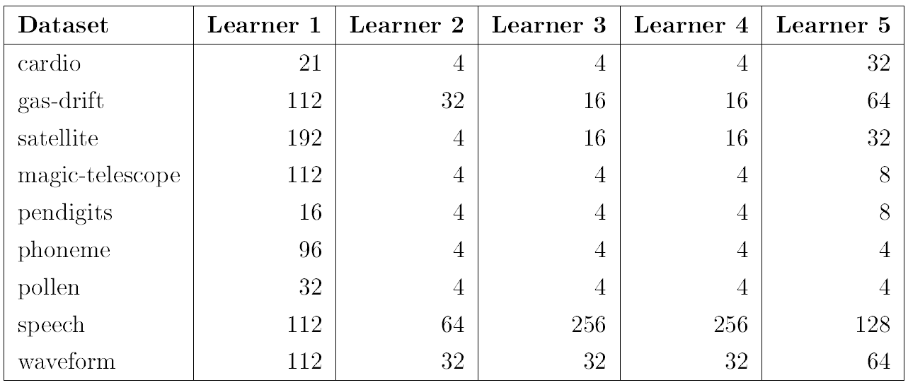
The Approach with Autoencoder Ensemble Models
Learner 1 is the optimized autoencoder
Table 3: Hyperparameter values initialized for each type of base learners
Table 4: Latent size used to train each type of base learners for each dataset
Notes:
For the purpose of next experiments, we have 5 different type of base learners, which have the same autoencoder architecture introduced before, but initialized with a different set of parameters.
-

Slide 18
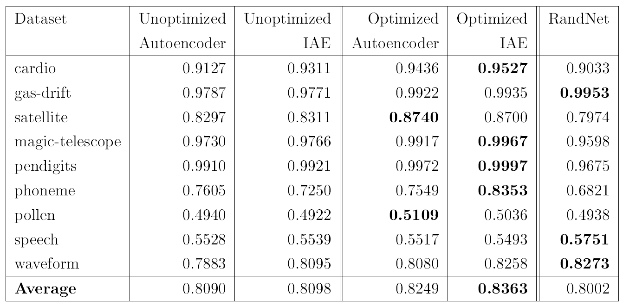
Performance of IAEs
RandNet contains 200 autoencoder models
The unoptimized IAE contains 60 unoptimized autoencoders
The optimized IAE contains 60 optimized autoencoders
Table 5: Comparison AUC scores of autoencoders, IAES, and RandNet[1]
Notes:
- Firsty, we will analyze the performance of independent autoencoder ensembles
- RandNet is an independent ensemble in which some of the connections between layers in each autoencoder included are randomly dropped.
- The RandNet from the source [1] contains 200 autoencoder models. Each model is initialized with an epoch of 300 and a batch size of 100. The latent size of each autoencoder submodel is adjusted based on the parameter alpha and the number of features of the dataset used.
- We generated an independent autoencoder ensemble architecture for experiments. To ensure that all base learners are diverse, we set a different random seed value for each autoencoder used. The final reconstruction errors of a trained independent ensemble is the average of all prediction errors of its base detectors.
- Table 5 shows the AUC scores of different autoencoders, IAES, and RandNet.
- As we can see, the optimized autoencoder indicates a better result than the unoptimized as the former’s parameters were fine-tuned very well, whereas the latter were randomly selected.
- The performance of both autoencoder models exceeds the RandNet, an independent ensemble containing 200 submodels.
- Both IAEs obtained better performance than their components
-
-

Slide 19
Performance of IAEs
The performance of both autoencoder models exceeds the RandNet:
The improper latent sizes initialized for each submodel in the RandNet
The removed connections may bring the important information that should be learned
Dropping randomly some connections between layers in each autoencoder may generate submodels with low variances
Both IAEs obtained better performances than their components:
IAEs are constructed with the goal of diversity between base learners by setting a different random seed value for each component
Components with high variances can learn different aspects of the patterns in data and hence boost the robustness of their ensemble
Notes:
- Some reasons for the poor performance of RandNet may result from the improper latent sizes initialized for each submodel in the RandNet
- The improper latent sizes initialized for each submodel in the RandNet
The removed connections may bring the important information that should be learned
Dropping randomly some connections between layers in each autoencoder may generate submodels with low variances
- on the other hand, our IAEs are constructed with an assurance about the diversity between base learners by setting a different random seed value for each component
- Overall, whether an independent autoencoder ensemble may outperform its base learners depends mainly on the variance between the latter. Components with high variances can learn different aspects of the patterns in data and hence boost the robustness of their ensemble.

Slide 20
Performance of SAEs and FSAEs
Sequential Autoencoder Ensemble (SAE):
The prediction error of the last trained learner is used to correct the error of the next one.
Full Sequential Autoencoder Ensemble (FSAE):
The prediction errors of all previously trained learners are used to correct the next one.
These proposed techniques are expected to generate autoencoder models with high variances and thus become robust ensembles
Notes:
Now, we analyze the performances of SAE and FSAE
Just a quick reminder
…

Slide 21
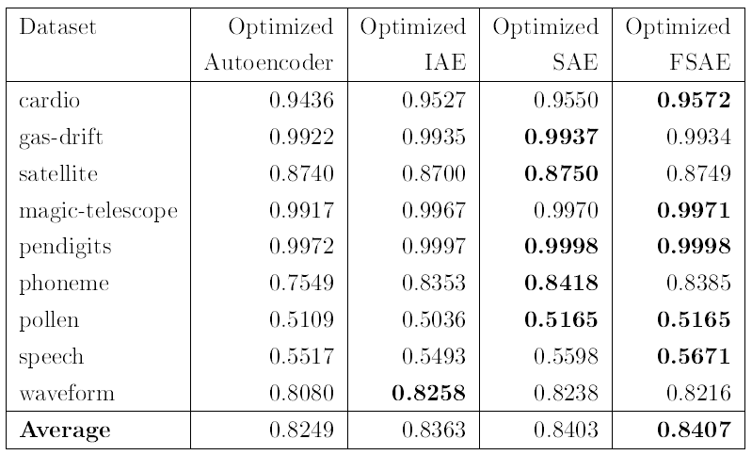
Performance of SAEs and FSAEs
Each ensemble contains 60 optimized autoencoders as base learners.
Both the optimized SAE and FSAE seems to behave similarly and outperform the optimized IAE as well as their base learners.
Table 6: Comparison AUC scores of autoencoder model, IAE, SAE, and FSAE
Notes:
- The table 6 gives an overview of the AUC scores of all datasets fitted to different models
- Each semble in table 6 contains 60 optimized autoencoders as base learners
- Although the average AUC score of the optimized FSAE is higher than that of the optimized SAE, it is not significant.
Both of them seems to behave similarly and outperform the optimized IAE as well as their base learners, the optimized autoencoder.

Slide 22
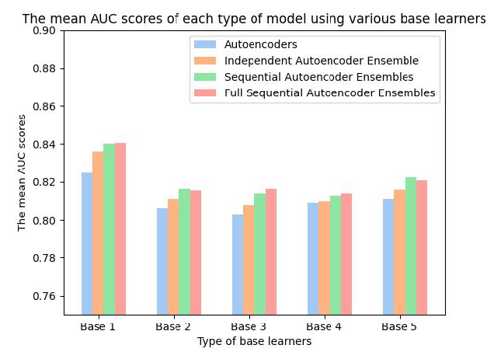
Performance of SAEs and FSAEs
Each ensemble contains 60 base models of a particular type of learners from 1 to 5
All SAEs and FSAEs perform better than their base learners
The performance of IAEs cannot exceed that of SAEs and FSAEs
Figure 12: Comparison the average AUC scores of autoencoder model, IAE, SAE, and FSAE using different type of base learners
Notes:
- We trained different ensembles containing 60 components of a particular type of learners from 1 to 5 as mentioned before.
- Figure 12 indicates the average AUC scores of different models trained with every dataset.
- As we can see, FSAEs behave similarly to SAEs, even though some FSAEs perform better than SAEs. The performances of all IAEs still cannot exceed that of FSAEs. Moreover, both FSAEs and SAEs outperform significantly their base learners.

Slide 23
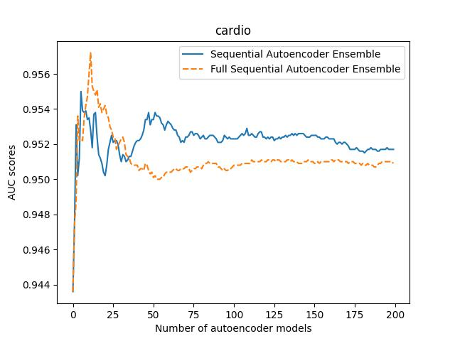
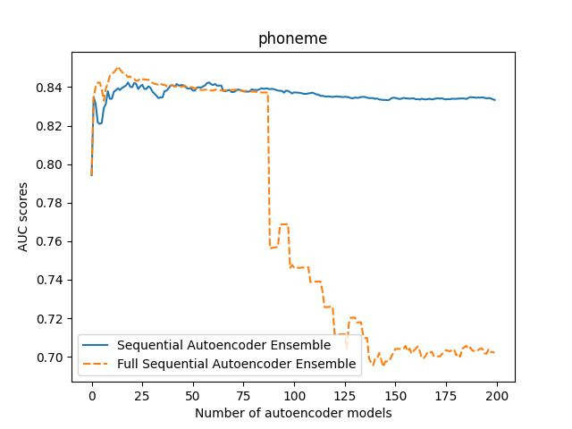
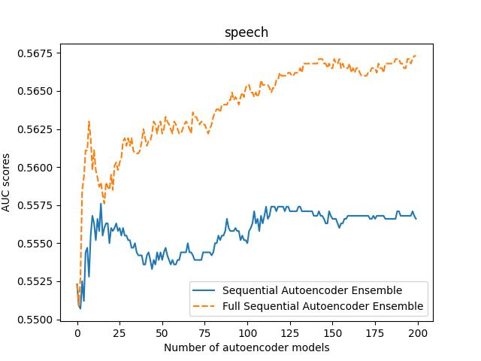
Performance of SAEs and FSAEs
Figure 13: ROC AUC performance of each dataset relates to the number of base learners in SAE and FSAE
The number of components in a SAE and FSAE affect the AUC score of a dataset substantially.
To achieve a robust ensemble at low computational cost, optimizing the number of components in an ensemble is generally vital.
Notes:
- To examine the influence of the number of base learners in an ensemble on its performance, we train each sequential and full sequential autoencoder ensembles for each number of models from 2 to 200,
- The number of components in a SAE and FSAE affect the AUC score of a dataset substantially. The performances of SAE and FSAE reach the convergence at some point, where the former keeps stable or starts to decrease when the number of base learners in the ensemble increases.
-> Therefore, to achieve a robust ensemble at low computational cost, optimizing the number of components in an ensemble generally is vital.

Slide 24
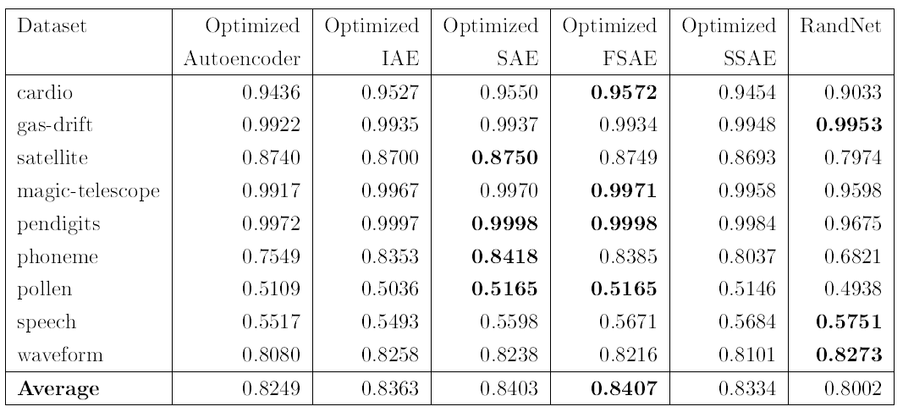
Performance of SSAE
The optimized SSAE contains 5 components
The optimized IAE, SAE, and FSAE contain 60 components
The RandNet contain 200 components
Table 7: Comparison AUC scores of autoencoder, IAE, SAE, FSAE, SSAE, and RandNet[1]
Notes:
- Next, I’d like to discuss the performance of SSAE
- To evaluate the performance, we train at first a synchronizing sequential autoencoder ensemble containing 60 optimized autoencoders. However, as the number of features of each dataset fitted into each base learner will increase dramatically after every iteration, we receive an error related to the system’s limited computational capacity.
- Finally, we train only an SSAE with 5 optimized autoencoders as components.
- Table 7 shows the AUC scores of different types of models.
- Even though this seems like an unfair comparison for the optimized SSAE, it performs quite well in this experiment. Its average AUC score exceeds not only the optimized autoencoder but also the RandNet.

Slide 25
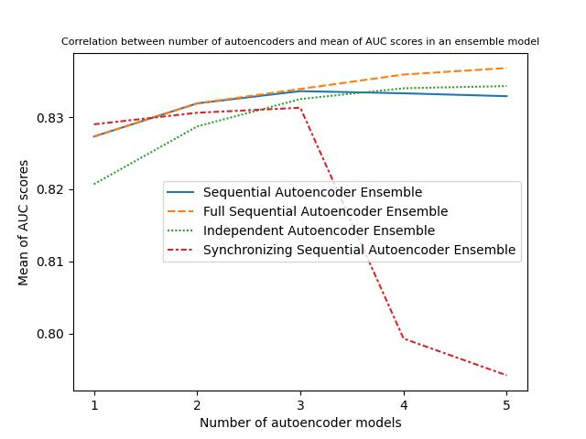
Performance of SSAE
The average AUC scores of IAE, SAE, and FSAE keep increasing
After increasing continuously in the first three base learners, the AUC performance of the SSAE drops dramatically.
Figure 14: Comparison the average AUC score of IAE, SAE, FSAE, and SSAE
Notes:
- The figure 14 demonstrates the average AUC scores of all datasets related to each number of base learners in an ensemble.
- We see that the average AUC scores of IAE, SAE, and FSAE keep increasing when the number of base learners rises. But, the most interesting property is that after increasing continuously in the first three base learners, the AUC performance of the SSAE drops dramatically.

Slide 26
Performance of SSAE
The AUC performance of the SSAE drops dramatically:
One reason for the decreasing AUC performance may result from the unsuitable latent size of the base learners
Since the amount of features in every dataset increases multiple after each iteration, we may need to adjust the latent size reasonably for each component in an SSAE, instead of keeping it unchanged as proposed.
SSAE could be potential and valuable for future works, as it seems to learn very fast and perform well after the first few base learners.
Notes:
- One reason for the decreasing AUC performance may result from the unsuitable latent size of the base learners.
- Since the amount of features in every dataset increases multiple after each iteration, we may need to adjust the latent size reasonably for each component in an SSAE, instead of keeping it unchanged as proposed.
- because there are some limitations in the computational capacity of our system and several adjustments in the algorithm of an SSAE may be required to obtain a more robust ensemble, we will not go further to study this kind of ensemble in our thesis.
- However, the synchronizing sequential autoencoder ensemble architecture proposed could be potential and valuable for future works, as it seems to learn very fast and perform well after the first few base learners.

Slide 27
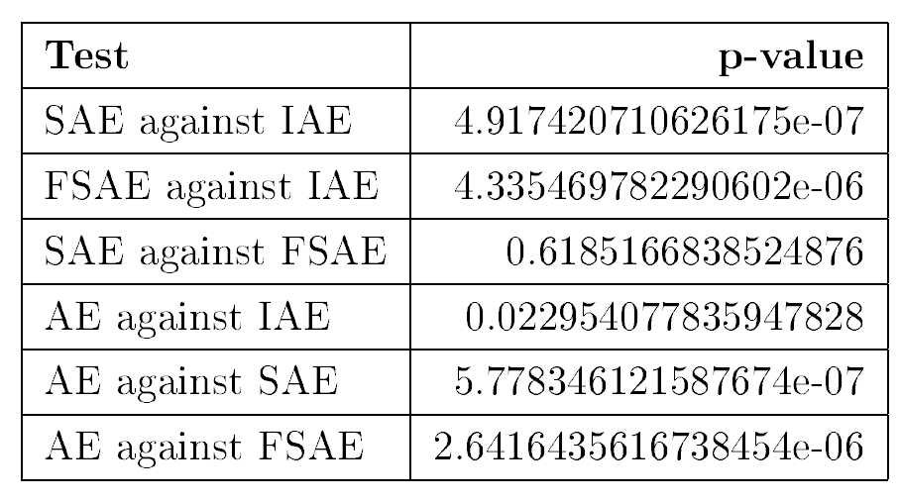
Models Evaluation
Wilcoxon hypotheses:
H0: the differences in the performances of the two models are significant
H1: Their performances are similar
p-value <= 0.01 : H0 is true
In general:
Both proposed SAE and FSAE perform better than IAE in general
A SAE behaves similarly to a FSAE.
Table 8: The p-values obtained by implementing the Wilcoxon tests
Notes:
- To determine whether the performances of a SAE and FSAE are significantly different than an IAE, we use a Wilcoxon test.
- we execute Wilcoxon tests with the null hypothesis is that the differences in the performances of the two models are significant, and the alternative is that they are the same
- The null hypothesis is not rejected if the p-value is less than 1%
- The p-value of each test is listed in table 8.
- We see that all tests indicate that differences in the performances of the two models are statistically significant at p < 0.01, except for the test between SAE and FSAE.
- Whereas both SAE and FSAE perform significantly better than IAE, the difference in their performances are not significant.
- Although an independent autoencoder ensemble performs better than their base learners, the improvement is not signicant.
Meanwhile, we witness signicant improvements of sequential and full sequential autoencoder ensembles in comparison with their base learners

Slide 28
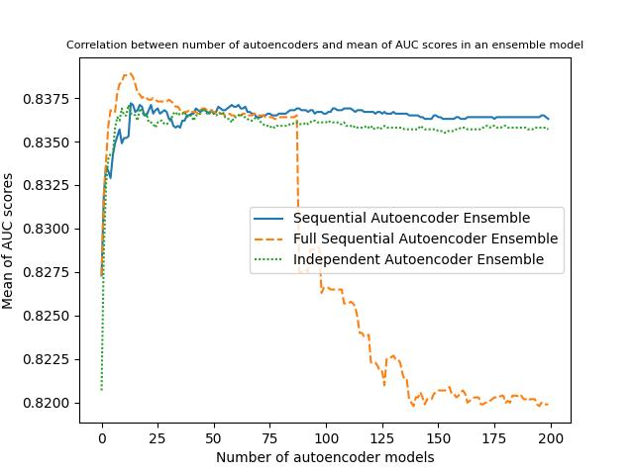
Models Evaluation
The performances of ensembles reach the convergence with fewer than the first 25 submodels
The AUC scores seem approximately constant from some point for SAE and IAE
A FSAE tends to learn and obtain the best performance much faster than the other.
The performance of FSAE starts to drop dramatically, when the latent size of each autoencoder becomes unsuitable with the dataset fitted to it
Figure 15: The average AUC scores of all datasets related to each number of components in an ensemble
Notes:
- The figure 15 summarizes the average AUC scores of all datasets related to each number of components in an ensemble
- The performances of ensembles reach the convergence with fewer than the first 25 submodels
- The AUC scores seems approximately constant from some point for SAE and IAE:
This is reasonable because there is no interaction between base learners in an IAE. For SAE, a current component learns from the predecessor‘s reconstruction error which is adjusted by learning from the previous submodel to correct ifself. Accumulatively, reconstruction errors are learned and adjusted to a minimum, then at some point, the next submodel has nothing to learn from ist predecessor and hence keeps stable.
It is similar for FSAE. However, a component in a FSAE learns from all previous submodels to adjust itself. Therefore, a FSAE tends to learn and obtain the best performance much faster than the other.
As the number of components in a FSAE continues to increase, the number of features of the dataset fitted to the next iteration also rises proportionally, while the latent size of each autoencoder is unchanged.
It leads to the base learners in later iterations starting to perform poorer than their predecessors, when their latent sizes become unsuitable with the dataset fitted to them

Slide 29
04
Conclusion and future work

Slide 30
Conclusion
An autoencoder model containing only a few hidden layers can perform very well, when it is initialized with suitable hyperparameters
Latent space has the most influence on the performance of an autoencoder
IAE, SAE, FSAE, and SSAE perform better than their base learners
The performances of SAE and FSAE techniques exceed that of IAE significantly
SAE and FSAE models behave quite similarly to each other.
A FSAE model seems to learn faster than a SAE

Slide 31
Future Work
FSAE and SSAE techniques could be potential and valuable for future work
Tuning hyperparameters of an ensemble like latent space, epoch, and batch size
Tuning loss function of components in an ensemble
The optimization of the number of components in an ensemble
Notes:
Full and synchronizing sequential autoencoder ensemble techniques could be potential and valuable for future work since they seem to learn very fast and perform well after the first few submodels in our experiments. By adjusting the latent size of each autoencoder to become adaptive with each dataset fitted into the model, we may expect some improvements in the performance of full and synchronizing sequential autoencoder ensembles
Moreover, further studies about tuning hyperparameters of an ensemble could be essential
it could be a promised aspect to dig deeper into tuning loss function. While implementing experiments to figure out the most suitable autoencoder architecture for our thesis, we realized that the loss function plays a crucial role in the efficiency of a model.
Another aspect is the number of components in an ensemble. We have seen that increasing the number of submodels in an ensemble improves its performance. However, the more base learners in an ensemble does not mean the better it performs. Meanwhile, it leads to higher computational costs. Therefore, it will be worthy to research further about the optimization of the number of components in an ensemble.

Slide 32
Thanks for listening

Slide 33
Approach of this Bachelor Thesis
Develop various sequential autoencoder ensemble techniques:
Sequential Autoencoder Ensemble (SAE)
Full Sequential Autoencoder Ensemble (FSAE)
Synchronizing Sequential Autoencoder Ensemble (SSAE)
Explore performance of autoencoder for anomaly detection :
Hyperparameters analysis
Performance of autoencoder
Explore performance of the above ensemble techniques:
Performance of different sequential autoencoder ensemble techniques
Models evaluation
Notes:
However, these architectures tend to produce similar base learners. As a low variance between components, it may not obtain more significant improvements than using an individual autoencoder. To address the problem of variance, we propose various sequential autoencoder ensemble techniques
The main point is that prediction errors of previous submodels participate directly or indirectly in correcting errors of the next one. Thus, our techniques can generate autoencoder models with highly different results. This diversity between submodels allows them to learn various aspects of the underlying patterns [14] and support each other to boost the robustness of their ensemble.

Slide 34
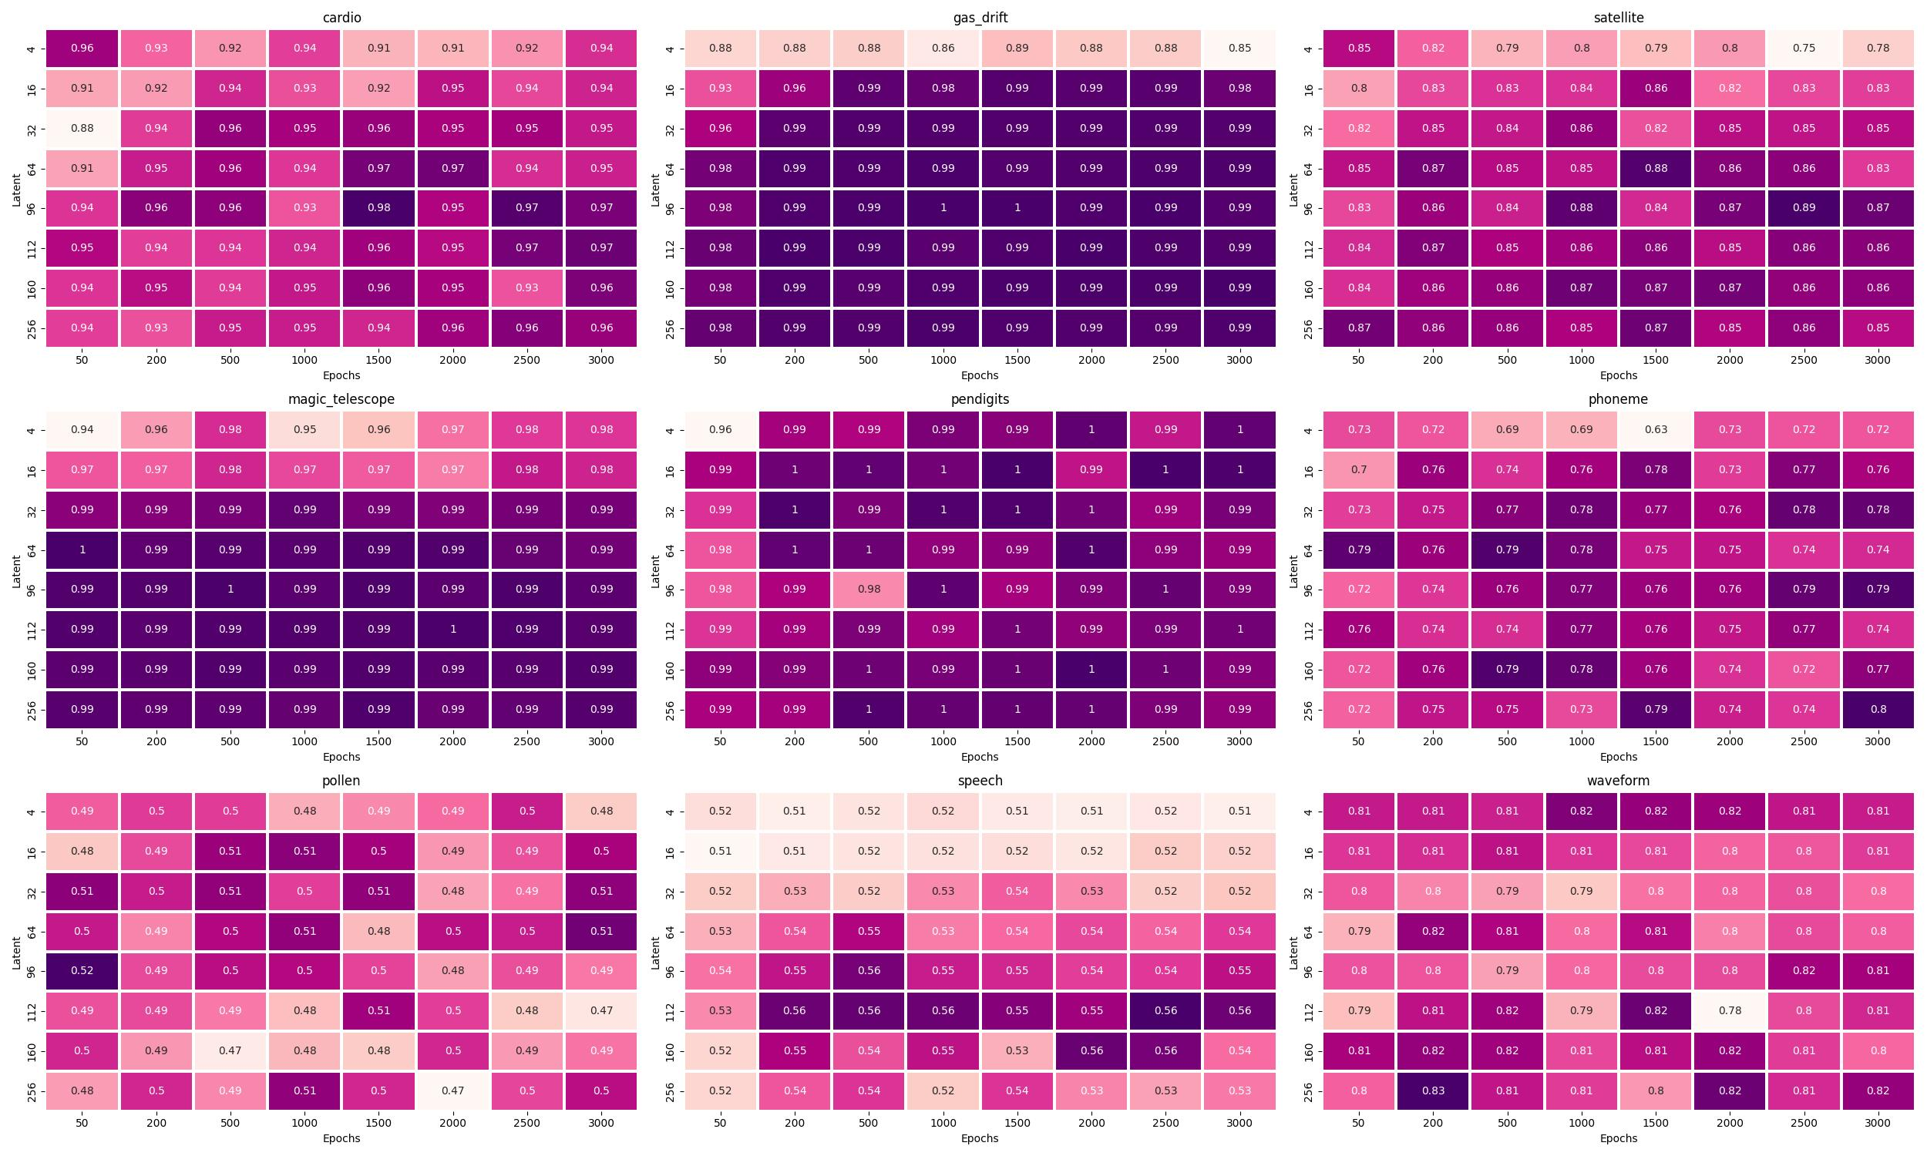
2. Latent Space analysis
The Approach with Autoencoder Model
Figure 9: Correlation between latent space and epoch size
Notes:
- The figure 9 summarizes heapmat plots of all datasets. We can see that if we choose a couple of latent space and epoch parameters, in which the former is really small and the latter is too big, or vice versa, then the most models tend to obtain a lower AUC score
- The highest AUC scores of each dataset concentrate mainly on the middle, bottom right or top left of the plot, where the distance between latent space and epoch values is not too big.
- Of course, to prove the accuracy of the statement, we need to do more experiments, which are supposed to reach out of this thesis.
- However, this exploration can be considered an effective suggestion to find the most effective couple of latent space and epoch values for each dataset.

Slide 35
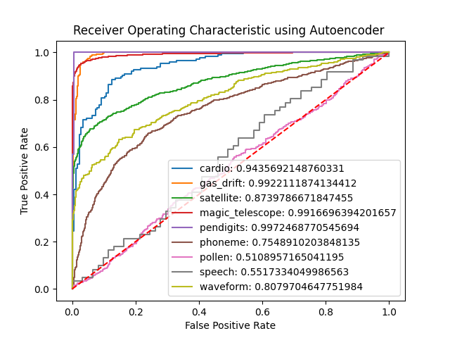
3. Performance of autoencoder
The Approach with Autoencoder Model
An autoencoder model containing only a few hidden layers can perform very well, when it is initialized with suitable hyperparameters
Searching for appropriate parameters may lead to a high computational cost and be time-consuming.
This approach is not effective since it does not generalize about all anomaly detection problems
Figure 11: The ROC curves of various datasets trained with autoencoder models
Notes:
- Figure 11 shows the ROC curves and AUC scores of various datasets trained with the autoencoder models.
- As we can see, most autoencoder models performed very well except for those using Pollen Speech datasets, which are actually difficult to train.
- To have these excellent autoencoder models, we implemented various experiments to figure out the most proper hyperparameters for each dataset.
.- An autoencoder model containing only a few hidden layers can perform very well, when it is initialized with suitable hyperparameters
- Searching for appropriate parameters may lead to a high computational cost and be time-consuming.
- This approach is not effective since it does not generalize about all anomaly detection problems. That means we need to find a proper hyperparameter set for a particular dataset to be able to train a well-performing autoencoder model.

Slide 36
References
[1] Tensorow implementation of "Outlier Detection with Autoencoder Ensembles" by J.Chen, S. Sathe, C. Aggarwal and D. Turaga. https://github.com/psorus/RandNet. Accessed: 2023-11-09.

Slide 37
Motivation for Anomaly Detection
Anomaly Detection:
The process of finding objects of a given dataset that behave very different from expectation
Unsupervised Anomaly Detection:
Autoencoders
Independent Ensemble Methods: RandNet
Figure 1: An example of anomalies in a two-dimensional dataset
The problem of low variance between components in an ensemble
The opportunity for sequential ensemble techniques
Notes:
Depending on the availability of labeled data, it could be considered to solve an anomaly detection problem with supervised, semi-supervised, or unsupervised learning.
However, having labeled datasets for anomaly detection problems could be very challenging in real-world scenarios, especially when the volume of data becomes larger and larger, which is occurring in this new era of big data. Therefore, unsupervised anomaly detection problems have obtained more attention from studies.
the most powerful algorithms for unsupervised anomaly detection is autoencoder,
the approach to leveraging the strength of various models to generate a more robust model, which is known as the ensemble method, has been explored widely for anomaly detection problems. The most remarkable architectures are independent autoencoder ensembles, which combine multiple autoencoder models in many different ways. RandNet is one of the most remarkable architectures.
However, these architectures tend to produce similar base learners. As a low variance between components, it may not obtain more significant improvements than using an individual autoencoder. To address the problem of variance, we propose various sequential autoencoder ensemble techniques

Slide 38
2. Latent Space analysis
The Approach with Autoencoder Model
Inspect the effect of latent size:
Latent sizes = {4, 8, 16, 32, 64, 96, 112, 128, 144, 160, 192, 256, 320}
Epoch = 2000
Batch = 64
By setting a suitable latent space, we can train an outperformed autoencoder model with only a shallow neuron network
The latent space of an autoencoder does not need to be smaller than the number of features of a dataset. A dataset with few features can get the highest AUC score by using an autoencoder with a large latent space
Figure 8: The influence of latent size
Notes:
- For each dataset, we trained multiple autoencoder models with different latent space values in {}. The whole trained models were initialized with a batch size of 64 and an epoch size of 2000.
- The figure 8 indicates the correlation between the latent space parameter and AUC scores
- The experiments has proved that the latent space parameter affects significantly the performance of an autoencoder model. As we can see in the plot, there is a substantial fluctuation in AUC scores concerning latent sizes of autoencoders, except for those of gas-drift, magic-telescope and pendigits datasets, which are quite easy to train.
- In general, by setting a suitable latent space, we can totally train an outperformed autoencoder model with only a shallow neuron network.
- By setting a suitable latent space, we can totally train an outperformed autoencoder model with only a shallow neuron network. However, it may cause a high computational cost to figure out the best latent space for a particular dataset as it seems that there are no fixed principles to support the finding process more effectively.
- From experiments, we see that the latent space of an autoencoder does not need to be smaller than the number of features of a dataset. A dataset with few features can get the highest AUC score by using an autoencoder with a large latent space

